Slide 1
A New Era for Student Loans in Bankruptcy: New Rules, Real Solutions
January 2026

Slide 2

SPEAKER INTRODUCTION
Igor Roitburg | Senior Managing Director
With over 25 years of combined legal, bankruptcy industry and technology proficiency, Igor brings considerable expertise to his role as Senior Managing Director. Prior to joining Stretto, he served as COO at Default Mitigation Management LLC (DMM). While at the company Igor co-created the DMM Portal, the industry’s leading technology platform specifically designed to facilitate mortgage and student loan debt resolution. With Stretto’s acquisition of DMM, Igor is responsible for overseeing the day-to-day development and integration of the DMM Portal. He directs a team of subject-matter experts who are focused on expanding adoption of both the mortgage and student loan modification programs with the goal of making debt resolution a more simplified process for an increased number of nationwide borrowers. Having earned his J.D. from Cornell Law School, Igor is respected by Stretto’s debtor Attorney clients for having a thorough understanding of the consumer bankruptcy process and the administrative hurdles both lawyers and their clients must navigate to ensure a successful resolution. Internally, his colleagues value his particular expertise and the role he plays in enhancing the company’s suite of debtor Attorney products and services.
igor.roitburg@stretto.com
859.663.2928.

Slide 3
AGENDA
Student Loan Background and Facts
Discharging Student Loans
Repaying Student Loans
Tackling Student Debt in Bankruptcy
*See appendix for sources

Slide 4
Student Loan Background and Facts

Slide 5
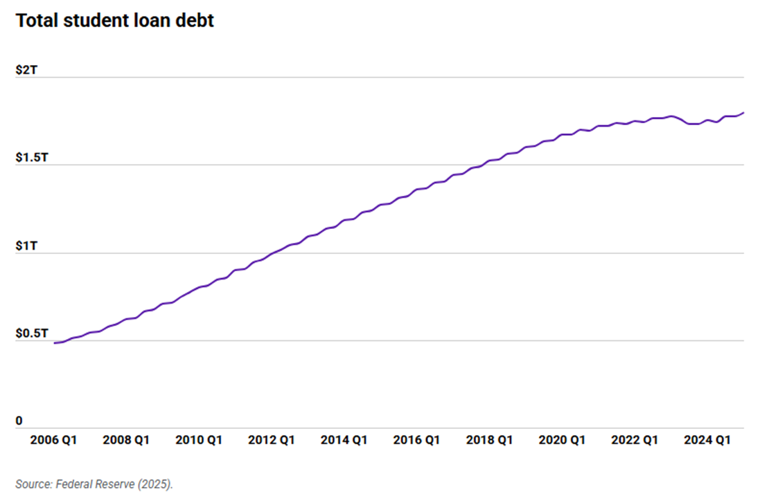
STUDENT LOAN BACKGROUND AND FACTS
$1.8 trillion as of Q1 2025…and growing!

Slide 6
STUDENT LOAN BACKGROUND AND FACTS
93% Federal student loan debt¹
43+M Borrowers have federal student loan debt²
$39,075 Average student loan debt held as of Q1 2025³
9.3M Borrowers are in default or seriously delinquent⁴
3X
Total federal student loan debt has roughly tripled since 2007.⁵
*See appendix for sources

Slide 7
Two Types of Loans – Federal and Private
STUDENT LOAN BACKGROUND AND FACTS
Federal
Private
Made or guaranteed by Federal government
Various programs – Direct, FFEL, Perkins
Since 2010, all loans are Direct
Credit checks not required (except for Parent PLUS limited “adverse credit history” check)
Special protections provided by law such as IDRs, subsidies, cancellation and forgiveness
No statute of limitation – debt collection can continue indefinitely with broad powers like wage garnishment and withholding of tax refunds
Made by private lending institution
Loans based on credit
Co-signer may be required
Rarely offered flexible repayment plans, cancellation or forgiveness options
Statute of limitations apply
No special collection powers

Slide 8
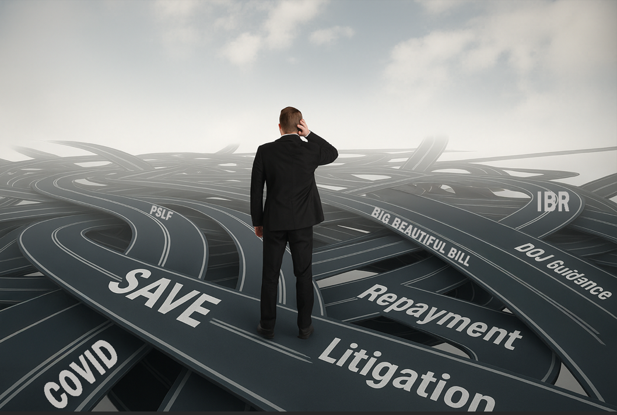
The last 6 years have been a(n even bigger) mess!

Slide 9
Six Years of Upheaval: From Pandemic Relief to Legislative Overhaul
STUDENT LOAN BACKGROUND AND FACTS
COVID Extensions
COVID Protections
Expire
Credit Reporting
Resumes
OBBB Passed
Old plans eliminated; new plans adopted; transition
COVID protections extended
Credits scores plummet
Interest and payments resume; on-ramp protections
October 2024
July 2025
2020 - 2023
September 2023
COVID Protections
SAVE Plan
SAVE Injunction
Collections Begin
COVID protections begin
Phase I rolled out
Courts block
implementation
Department of Education resumes collections – wage garnishments, etc.
March 2020
Summer 2023
July 2024
May 2025
2020
2023
2024
2025

Slide 10
Six Years of Upheaval: From Pandemic Relief to Legislative Overhaul
STUDENT LOAN BACKGROUND AND FACTS
March 2020: Initial COVID protections
Federal student loan payments and interest accrual suspended under CARES Act
2020 – 2023: Multiple extensions of COVID protections
Trump and Biden extend payment pause multiple times
Summer 2023: Initial rollout of SAVE plan (Phase 1)
Most generous income-driven repayment plan
Key benefits: waived unpaid interest and increased “discretionary income” protected from payment
Many borrowers achieved $0 payment
September 1, 2023: COVID protections end…sort of
Federal student loan interest resumed on September 1, 2023, and payments restarted in October 2023.
But, borrowers who miss monthly payments not considered delinquent, reported to credit bureaus, placed in default, or referred to debt collection agencies (the “On-Ramp”)

Slide 11
Six Years of Upheaval: From Pandemic Relief to Legislative Overhaul
STUDENT LOAN BACKGROUND AND FACTS
July 2024: SAVE injunction
Phase 2 not implemented (would have lowered undergrad payments and provided accelerated forgiveness timelines)
8 million borrowers placed in interest-free forbearance
October 1, 2024: Credit reporting resumed
Borrowers who missed payments reported as delinquent. Credit scores for millions of borrowers plummeted by 100+ points
May 2025: Department of Education announces collection activities to resume
Wage garnishments, social security offsets, tax refund intercepts begin once again
An estimated 25% of federal student loan portfolio is expected to be in default. Only 38% of borrowers are current.⁶
July 4, 2025: Passage of the “One Big Beautiful Bill”
Complete overhaul of repayment plans
Only new Standard and Repayment Assistance Plan (RAP) will remain post July 1, 2028
August 1, 2025: SAVE interest-free forbearance ends
Borrowers can remain in administrative forbearance, but interest accumulates

Slide 12
The Fallout: Key Issues Facing Borrowers
STUDENT LOAN BACKGROUND AND FACTS
Severe credit score damage
Delinquency and default
Growing balances
Loss of repayment options
Wage garnishments, social security offsets, and tax refund intercepts
Confusion and delay

Slide 13

Meanwhile…in bankruptcy
New opportunities emerge

Slide 14
New Opportunities: Managing Student Loans Through Bankruptcy
NEW OPPORTUNITIES IN BANKRUPTCY
Option 1: Discharging federal student loan debt using DOJ guidance
Option 2: Facilitating enrollment in repayment plans

Slide 15
Discharging Student Loans

Slide 16
Legal Framework
DISCHARGING STUDENT LOANS
Statute – 11 U.S.C. §523(a)(8)
Requires a showing of “undue hardship”
“Undue hardship” not defined
Case Law – Majority Standard
Brunner v New York State Higher Education Services Corp., 831 F.2d 395 (2d Cir. 1987)
The debtor cannot presently maintain a minimal standard of living if required to repay the student loan
Circumstances exist that indicate the debtor’s financial situation is likely to persist into the future for a significant portion of the loan repayment period
The debtor has made good faith efforts in the past to repay the student loan

Slide 17
Legal Framework
DISCHARGING STUDENT LOANS
Case Law – Minority Standard
In re Long., 322 F.3d 549, 553 (8th Cir. 2003) “Totality of Circumstances” test
The totality test looks to:
The debtor’s past, present, and reasonably reliable future financial resources;
A calculation of the debtor’s and their dependents’ reasonably necessary living expenses; and
Any other relevant facts and circumstances surrounding each particular bankruptcy case.

Slide 18
Legal Framework
DISCHARGING STUDENT LOANS
NEW! Department of Justice Guidance – November 17, 2022
2018: The Department of Education (under Trump 1.0) issued an RFI looking to develop a new policy for discharging student loans in bankruptcy
Focus was on how to better determine when an “undue hardship” exists
2022: The Biden Administration released guidance detailing how “undue hardship” cases would be processed
Relied on many of the comments received as part of 2018 RFI
2025: Trump DOJ authorizes guidance to remain in place
May 1, 2025 – Trump Admin updated the policy and the Attestation form on the DOJ site

Slide 19
Understanding DOJ Guidance
DISCHARGING STUDENT LOANS
Provides objective standards and streamlined process for determining if there is an “undue hardship”
Applies to Chapter 7s and 13s
Allows DOJ with DOE to stipulate that “undue hardship” exists and recommend discharge if three conditions are met:
The debtor presently lacks an ability to repay the loan
The debtor’s inability to pay the loan is likely to persist in the future
The debtor has acted in good faith in the past in attempting to repay the loan
Debtor submits Attestation form to determine if conditions met. Guidance spells out objective criteria for each requirement. (Avoids discovery and litigation)

Slide 20
How the DOJ Guidance Works
DISCHARGING STUDENT LOANS
File adversary complaint
No court filing fee
No fees to reopen
After adversary is filed, debtor must provide completed attestation to the DOJ
DOJ reviews attestation and consults with Department of Education
DOJ reports result to debtor attorney
If DOJ agrees there is “undue hardship”, submit to Court and request discharge
If DOJ does not agree, consult with client but most will not proceed (can explore repayment plan options)
87% resulted in full or partial discharge
(NYT: More Student Loan Borrowers Are Shedding Debts in Bankruptcy, 12/27/25)

Slide 21
Guidance Continues to Thrive
DISCHARGING STUDENT LOANS
Full steam ahead…
AUSAs advised to proceed with the guidance
Consent orders continue to be entered across the country
Department of Justice updated the attestation in May 2025
Provided new form
New IRS Standards
CNBC reports that Education Department spokesperson confirmed it has “no plans to change the approach” (CNBC: Bankruptcy success rate for student loan borrowers jumps to 87%, study finds, 12/30/25)

Slide 22
Discharging Private Loans
DISCHARGING STUDENT LOANS
Guidance does NOT apply, but …
Guidance does help define “undue hardship” which does apply
Federal loans are more borrower friendly with more options. As a result, may be easier to prove “undue hardship” with private loans
Discharges of federal loans will likely motivate more private lenders to settle

Slide 23
Repaying Student Loans

Slide 24
New Legislation Transforms Federal Student Loan Repayment Systems
REPAYING STUDENT LOANS
Existing plans eliminated as of July 1, 2028
ICR, PAYE, SAVE (old REPAYE)
New plans available as of July 1, 2026
New Standard
Repayment Assistance Plan (RAP)
Repayment options depend on:
Current repayment plan; and
If loans were taken / consolidation disbursed before or after July 1, 2026

Slide 25
Repayment Plan Availability
REPAYING STUDENT LOANS
Loans disbursed BEFORE July 1, 2026
If currently on Standard, Extended or IBR, can KEEP existing plan
If on ICR, PAYE or SAVE, must TRANSITION to new plan by July 1, 2028
Available plans: IBR, new RAP, current Standard, Graduated, or Extended
Loans disbursed ON or AFTER July 1, 2026
ONLY new Standard Plan or RAP Available. NO other options.

Slide 26
Existing Repayment Plans Still Available
REPAYING STUDENT LOANS
Standard – 10-year term
Graduated – 10-year term; payments step up every two years
Extended – Balance > $30K; 25 yr term
Extended Graduated – Balance > $30K; payments step up every two years; up to 25-year term
IBR – 15% of discretionary income; 25 yr term
IBR New (first loan after July 1, 2014) – 10% of discretionary income; 20-year term

Slide 27
New Standard Repayment Plan
REPAYING STUDENT LOANS
Fixed monthly payment; full loan amount repaid based on balance, term, and interest rate
Loan term determined by balance
10 years – if loan balance less than $25,000
15 years – if loan balance between $25,000 and $50,000
20 years – if loan balance between $50,000 and $100,000
25 years - if loan balance greater than $100,000

Slide 28
Repayment Assistance Plan (RAP)
REPAYING STUDENT LOANS
Payments
$0 - $10,000 AGI | $10/mo. min. payment | $60,001 - $70,000 AGI | 6% of annual income
$10,001 - $20,000 AGI | 1% of annual income | $70,001 - $80,000 AGI | 7% of annual income
$20,001 - $30,000 AGI | 2% of annual income | $80,001 - $90,000 AGI | 8% of annual income
$30,001 - $40,000 AGI | 3% of annual income | $90,001 - $100,000 AGI | 9% of annual income
$40,001 - $50,000 AGI | 4% of annual income | $100,001+ AGI | 10% of annual income
$50,001 - $60,000 AGI | 5% of annual income

Slide 29
Repayment Assistance Plan (RAP)
REPAYING STUDENT LOANS
Features
Income driven repayment plan based on total AGI (not discretionary income like prior IDRs)
Payment reduced $50 for each dependent child under 17
$10 minimum payment
Forgiveness timeline = 30 years
Waives unpaid monthly interest – no negative amortization!
Allows married borrowers to file taxes separately

Slide 30
Parent PLUS Loans – Major Issue
REPAYING STUDENT LOANS
NO IDRs available; NOT eligible for RAP
Parent PLUS borrowers will ONLY have access to Standard Repayment Plan
Could be completely unaffordable for many borrowers
Exception: Parent PLUS borrowers are eligible for IBR if
Fully consolidated before June 30, 2026
Enrolled in any IDR and made payment on IDR plan before June 30, 2028

Slide 31
Example: Parent PLUS
TACKLING STUDENT DEBT IN BANKRUPTCY
Debtor with $100,000 Parent PLUS loans in bankruptcy at 7%
No action during bankruptcy | Take action during bankruptcy
Post bankruptcy – can only enroll in new Standard Plan NO IDR options available post BK $706.78 / month payment 25-year term NO loan forgiveness | Submit by-right consolidation and IDR application IDR payment retained post BK $306.46 / month payment 20-year term Loan forgiveness

Slide 32
Tackling Student Debt in Bankruptcy

Slide 33
Serious Implications for Debtors in Bankruptcy
TACKLING STUDENT DEBT IN BANKRUPTCY
When debtors are in bankruptcy, federal loans are typically placed in administrative forbearance, which means servicers will not speak with them or process plan changes.
As a result, debtors currently in bankruptcy may lose ability to enroll in optimal repayment plan.
To solve, work with servicers to include plan language allowing debtor to enroll in and make payments under IDR, OR work through court Student Loan Management Program (where available).

Slide 34
Bankruptcy Action Plan
TACKLING STUDENT DEBT IN BANKRUPTCY
So, where
STOP the “nothing can be done” narrative
START identifying and reviewing options
SECURE solutions for your clients
do we GO
from
here?

Slide 35
STOP the “Nothing Can Be Done” Narrative
TACKLING STUDENT DEBT IN BANKRUPTCY
Federal student loans ARE dischargeable in bankruptcy
DOJ Guidance established streamlined and cost-effective process to discharge student loans
87% success rate (compare to 0.1% before Guidance)
Debtors can enroll in repayment plans while in bankruptcy
2018 U.S. Attorney Bulletin approves process
Debtors need to add plan language

Slide 36
START Identifying and Reviewing Options
TACKLING STUDENT DEBT IN BANKRUPTCY
Student Loans are the second largest consumer debt
Bankruptcy professionals have an ethical obligation to review alternatives for dealing with the debt
Must learn to identify available options and eligibility
Many debtors will lose rights and options (without even knowing it)
Discharge only possible through bankruptcy
Existing repayment plans will be lost
Parent PLUS borrowers will not have access to IDRs

Slide 37
SECURE solution for clients
TACKLING STUDENT DEBT IN BANKRUPTCY
Transform student loans from a bankruptcy dead-end into a managed pathway toward genuine financial recovery.
File adversary proceedings seeking discharge
Understand repayment options
Assist clients to enroll in repayment plans
Facilitate through plan language
Encourage court to adopt structured programs to facilitate discharges and repayment plans

Slide 38
Student Loan Management Program
TACKLING STUDENT DEBT IN BANKRUPTCY
Provides rules of engagement for debtor and loan holder to discuss available and consensual student loan resolutions
Allows parties to review and enroll in by-right repayment plans while in bankruptcy
Without a program, federal student loans are placed in administrative forbearance and debtor cannot enroll in repayment plans
Eliminates creditors’ concerns of Espinosa discharges, stay violations and court-imposed modifications
Program provides for standardized language and guidance
Uses online secure portal to facilitate communications
Adopted in five jurisdictions
DOE participated

Slide 39
Stretto DMM Portal | www.dclwp.com
TACKLING STUDENT DEBT IN BANKRUPTCY
Discharge Snapshot – FREE, quick assessment of dischargeability
Discharge Analyzer* – Comprehensive analysis of dischargeability and completed attestation
$29 for Report
$129 for Attestation
$350 Pro Service (on-demand expert paralegals prepare docs)
Repayment Plan Analyzer* -- Comprehensive analysis of available repayment plans and completed application materials
$29 for Report
$129 for Applications
* Included NSLDS parser which reads NSLDS and provides loan details
* See https://www.dclmwp.com/SLAP for more details

Slide 40
Helpful Information
Department of Justice Discharge Guidance
Department of Justice Attestation form (05-2025)
Model Bankruptcy Court Program

Slide 41
Questions?

Slide 43
Source Appendix
¹ https://educationdata.org/student-loan-debt-statistics
² https://educationdata.org/student-loan-debt-statistics
³ https://www.fool.com/research/student-loan-debt-statistics/#:~:text=Total%20student%20loan%20debt:%20$1.78,of%20all%20student%20loan%20debt
⁴ https://www.ed.gov/about/news/press-release/us-department-of-education-begin-federal-student-loan-collections-other-actions-help-borrowers-get-back-repayment
⁵ https://www.bestcolleges.com/research/average-student-loan-debt/
⁶ https://www.ed.gov/about/news/press-release/us-department-of-education-begin-federal-student-loan-collections-other-actions-help-borrowers-get-back-repayment

